Slide 1
On Placement and Dynamic Power Control Of Femto Cells in LTE HetNets
Vanlin Sathya, Arun Ramamurthy and Bheemarjuna Reddy Tamma
Networked Wireless Systems Laboratory (NeWS Lab)
Dept. of Computer Science and Engineering
Indian Institute of Technology (IIT) Hyderabad, India

Slide 2
Outline
Motivation
LTE HetNet architecture
Interference problem in HetNets
Proposed optimal placement & power control of LTE Femto cells
Performance Results
Conclusions & Future work

Slide 3
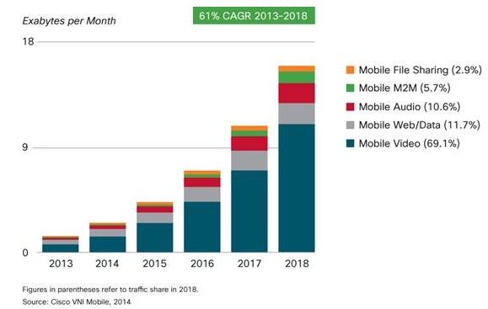
Trend 1
Motivation
In future video traffic will contribute to 70% of total cellular traffic.
So, BW demand is ever increasing!

Slide 4
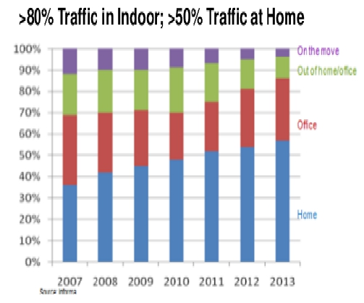
Trend 2
Motivation
Most of traffic is from Indoor users
Issues in indoors:
Poor cellular coverage due to obstructions & high freq. bands
So, poor data rates

Slide 5
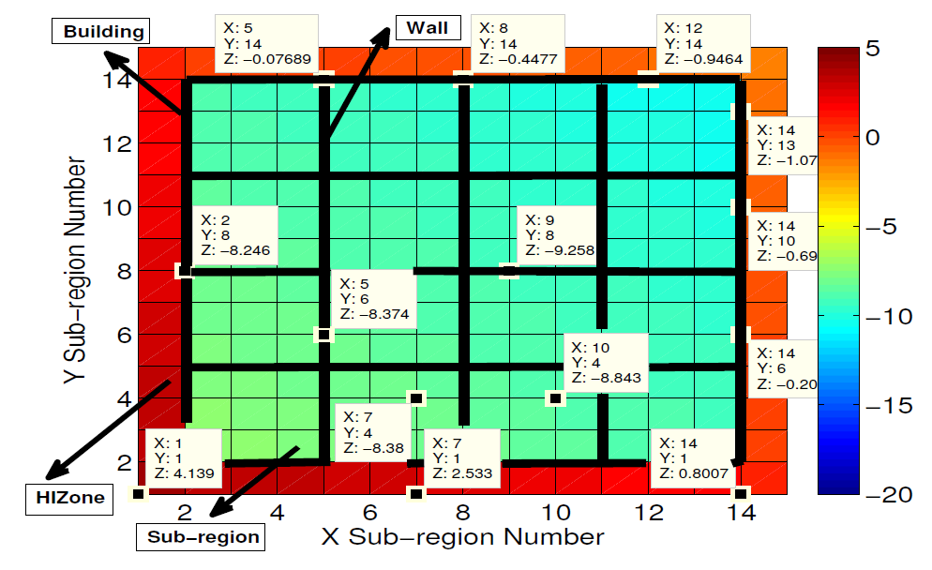
Only Macro Base Station
UEs in HIZone got good signal (> -1 dB)
Indoor UEs: -8 to -9 dB
eNodeB @ 350 m away
Notes:
1. Macro placed at 350m from south west direction, by taking into account path loss due to walls and floors

Slide 6
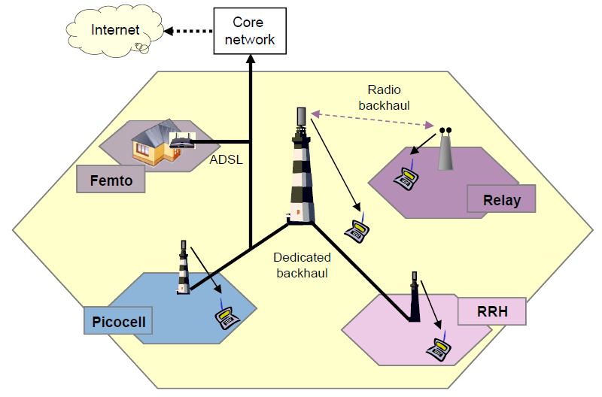
Solution: Heterogeneous Networks (HetNets)
Small Cells in LTE
Dense deployment in enterprises/hotspots
Low power nodes
Freq. Reuse 1 → high spectral efficiency, but need to contain
cross-tier co-channel interference
Boosts indoor coverage &
data rates
Open/Closed/Hybrid Access modes
Notes:
We assume resue 1 and Closed access mode in this work

Slide 7
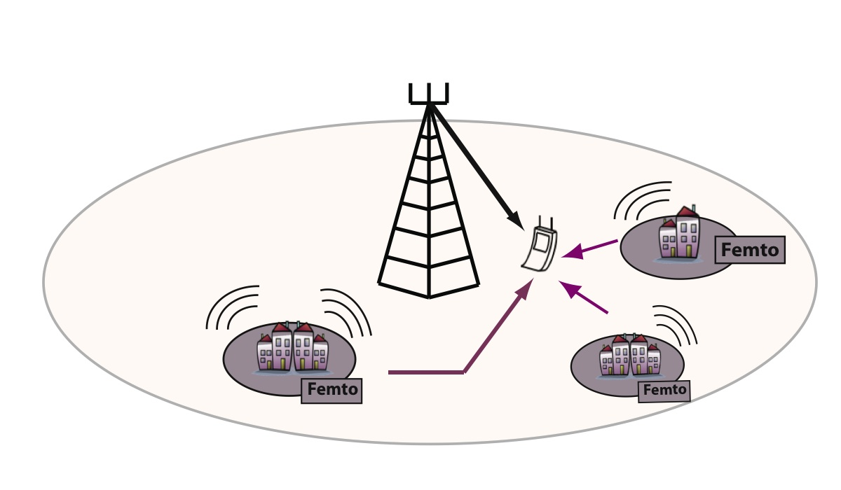
Cross-tier Interference Problem
Example of cross-tier interference between the Macro cell and Small cells located under its coverage area
Due to freq. reuse 1, we need to ensure that Femtos do not transmit with high power
Notes:
Due to reuse 1, UE outside homes (HIZone) getting interference from Femto Aps. Similarly, UEs inside Femtos can get interfered by macro BS, but not much as signals are quite weak

Slide 8


Co-tier Interference Problem
Example of co-tier interference between Femtos deployed indoors
A
B
C
Femtos: A, B,C
Room
Serving Signal
Interference Signal;

Slide 9
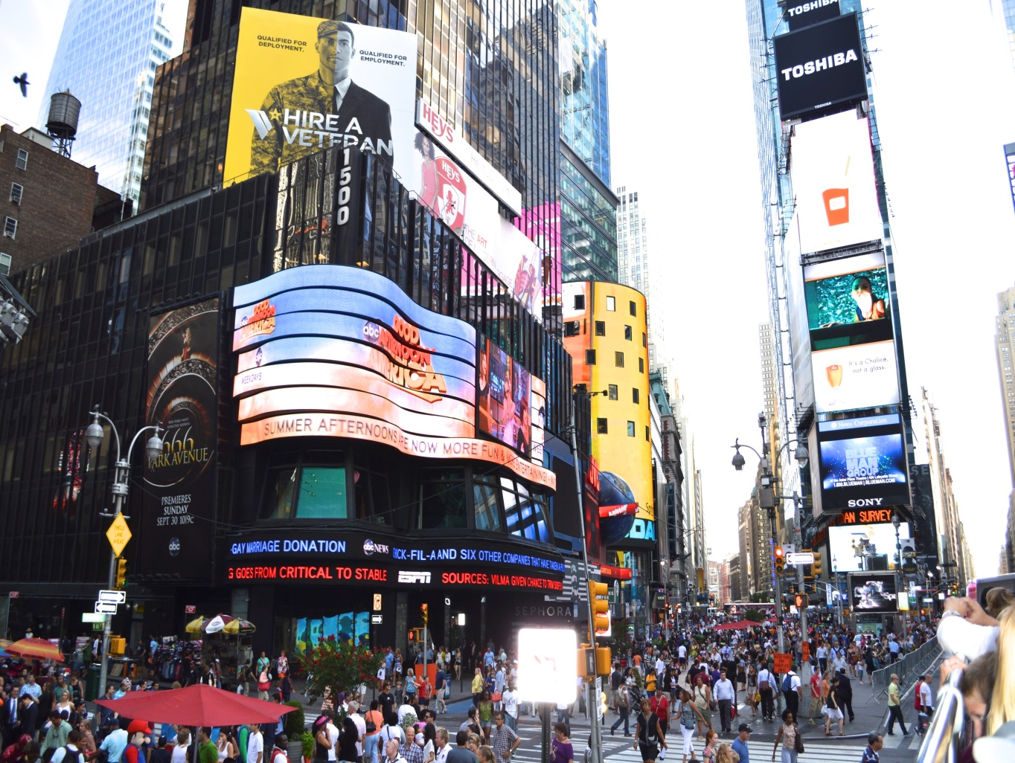
Scenario: Enterprise building in urban areas
Placement issue
Arbitrary placement of Femtos leads to co-tier & cross-tier interference
Power leakage from Femtos into HIZone
  Temporal variation in occupancy in HIZone
Optimal placement & Dynamic power control at Femtos ensure good SINR for indoor & HIZone outdoor UEs
eNodeB
Power Leakage from Femtos @ HIZones
Notes:
But in a real-world scenario, the Macro users may not always be there in the surroundings of the building, such as at nights.

Slide 10
Problem Statement & Work Done
Optimal placement of enterprise Femtos (static)
  Factors in Macro-Femto cross-tier co-channel interference
  Considers signal attenuation due to walls and floors
  Minimizes no. of Femtos to be deployed to cover the building
  Determines optimal locations for placing the Femtos
  Guarantees certain minimum threshold SINR (-2 dB) for indoor UEs
  But, all Femtos blast at full power to improve SINR of indoor UEs
Dynamic power control of enterprise Femtos in HetNets
  Considers outdoor UE occupancy in HIZone (Macro gives it to F-GW)
  Adaptively adjusts tx power of Femtos
  Guarantees certain minimum threshold SINR (-4 dB) for indoor UEs
  Guarantees that outdoor HIZone UEs SINR degradation < 2 dB
  Proposed efficient placement and power control algorithm by solving
  two Mixed Inter Programming (MIP) problems
    MinNF: Minimize number of Femtos
    OptFP: Optimal Femto Power
Notes:
Optimal placement does not factor in outdoor Ues in HIZone, so causes lot of interference to HIZone Ues and degrades their SINR. Effect of Macro UE on indoor Ues in modelled in the system

Slide 11
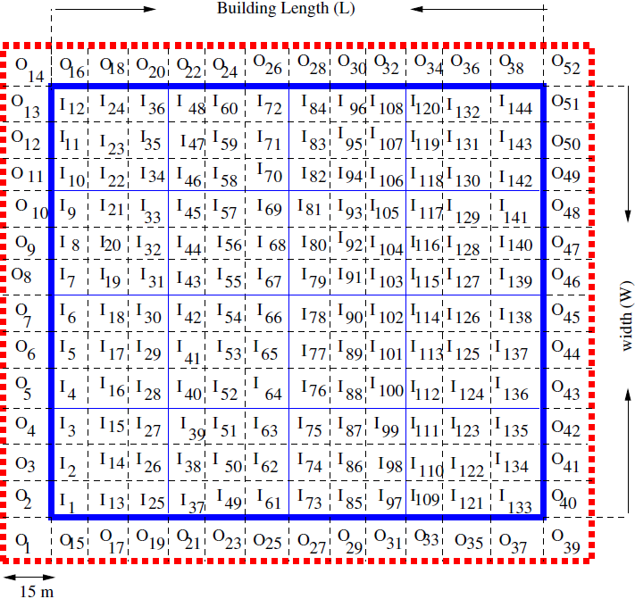
Bird-eye view of floor area inside and outside enterprise building considered
Outer sub-
region number
Inner sub-
region number
HIZone
Wall
Room
Notes:
We consider a simplified building of L*W for the placement study. Each room is further logically divided into smaller sub-regions. Assuming uniform transmission power across sub-channels. Within every sub-region, the SINR value is almost constant as it’s very small.

Slide 12
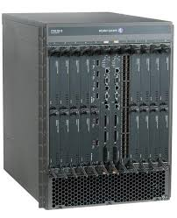
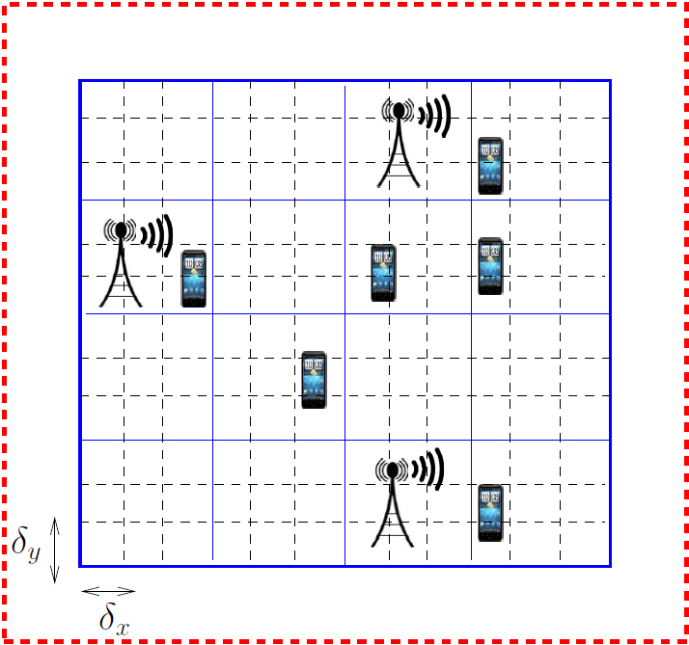
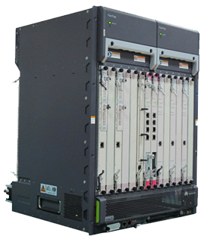
LTE Femto SON Architecture
SON
Inner sub-region
Wall
S1
S1
S1
Femto
GW
S1
Femto
MME
S1
eNodeB
Building
HIZone

Slide 13
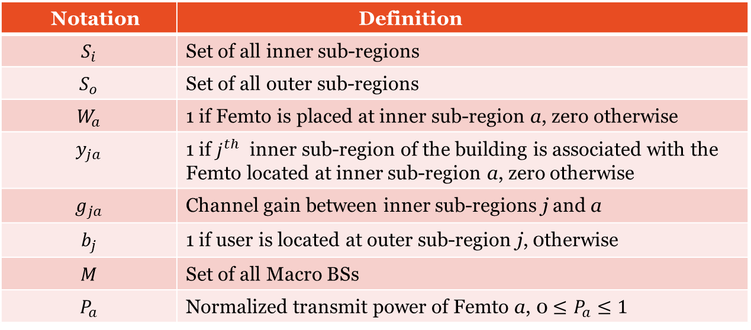
Channel Model and Notations Used
Path loss b/w Macro BS and indoor/outdoor UE at a distance of d:
Path loss b/w Femto and indoor UE at a distance of d:
Channel gain for Macro and Femto are 20 dBi and 2 dBi, respectively
Notation | Definition
$$S_{i}$$ | Set of all inner sub-regions
$$S_{o}$$ | Set of all outer sub-regions
$$W_{a}$$ | 1 if Femto is placed at inner sub-region a, zero otherwise
$$y_{ja}$$ | 1 if $j^{th}$ inner sub-region of the building is associated with the Femto located at inner sub-region a, zero otherwise
$$g_{ja}$$ | Channel gain between inner sub-regions j and a
$$b_{j}$$ | 1 if user is located at outer sub-region j, 0therwise
$$M$$ | Set of all Macro BSs
$$P_{a}$$ | Normalized transmit power of Femto a, 0 $≤P_{a}≤1$

Slide 14

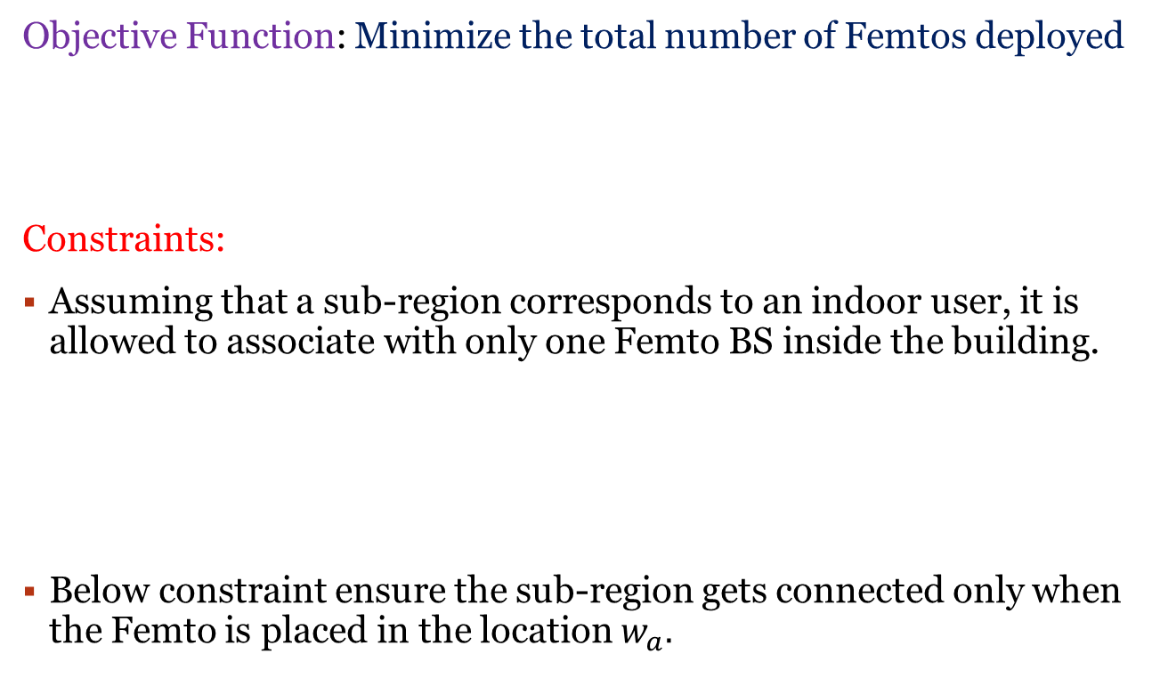


MinNF MIP Formulation
Objective Function: Minimize the total number of Femtos deployed
Constraints:
Assuming that a sub-region corresponds to an indoor user, it is allowed to associate with only one Femto BS inside the building.
Below constraint ensure the sub-region gets connected only when the Femto is placed in the location $w_{a}.$
$$\min{\sum_{a∈S_{i}}{w_{a} }}$$
$$\sum_{a∈S_{i}}{y_{ja}=1 ∀j∈S_{i} (1)}$$
$$y_{ja}−w_{a}≤ 0 ∀j,a∈S_{i} (2)$$

Slide 15

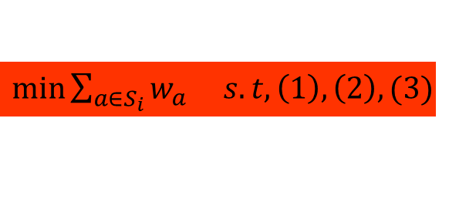
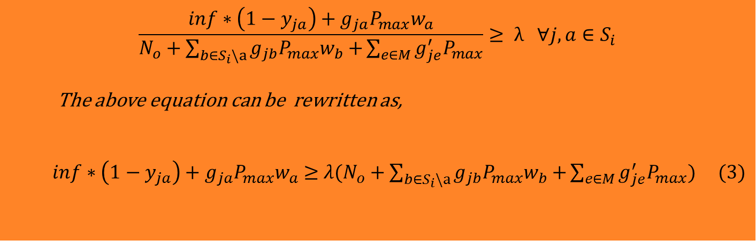
MinNF MIP Formulation
To ensure good coverage, the SINR of inner sub-regions must be maintained above the predefined threshold SINR, $λ$ and is given by
$$($$
$$\frac{inf∗\left(1−y_{ja}\right)+g_{ja}P_{max}w_{a}}{N_{o}+\sum_{b∈S_{i}\backslash a}{g_{jb}P_{max}w_{b}+}\sum_{e∈M}{g_{je}^{′}P_{max}}}≥ λ ∀j,a∈S_{i}$$
The above equation can be rewritten as,
$inf∗\left(1−y_{ja}\right)+g_{ja}P_{max}w_{a}≥$ ${λ(N}_{o}+\sum_{b∈S_{i}\backslash a}{g_{jb}P_{max}w_{b}+}\sum_{e∈M}{g_{je}^{′}P_{max}) (3)}$
Finally, MinNF MIP is formulated as follows,
$\min{\sum_{a∈S_{i}}{w_{a} s.t, \left(1\right), \left(2\right), (3)}}$
Notes:
Inf is a virtually large value 10^6. W/o this, above equation requires all Femtos providing minimum threshold SINR to any given sub-region. But, just a single Femto is necessary to give SINR threshold for a given inner region. So the MIP will always be infeasible.

Slide 16



OptFP MIP Formulation
The objective is to reduce the Macro UEs SINR degradation by:
Optimal Femto power control to maintain ${SINR}_{Th}$in each inner sub- region and also maintain the SINR degradation at less than 2 dB in HIZone
Determine the Femto to which indoor UEs in any givensub-region have to be associated with
The Femto power value is set only when the Femto is placed at the location $w_{a}$
Objective Function: The Femtos can’t operate at the full power as the Macro UEs will experience higher SINR degradation
Constraints:
$$\max{\sum_{a∈S_{i}}{P_{a} }}$$
$P_{a}≤W_{a} ∀a∈S_{i}$ (4)

Slide 17


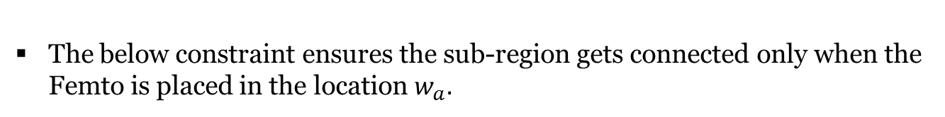
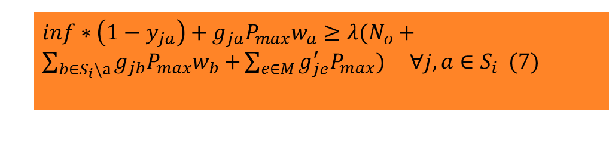

OptFP MIP Formulation
Each inner sub-region corresponds to an UE, but UE is allowed to associate with only one Femto:
To ensure good coverage, the SINR of inner sub-regions must be maintained above the predefined threshold $λ$ and is given by
$$\sum_{a∈S_{i}}{y_{ja}=1 ∀j∈S_{i} \left(5\right) }$$
The below constraint ensures the sub-region gets connected only when the Femto is placed in the location $w_{a}.$
$$y_{ja}−w_{a}≤ 0 ∀j,a∈S_{i} (6)$$
$inf∗\left(1−y_{ja}\right)+g_{ja}P_{max}w_{a}$ $≥{λ(N}_{o}+\sum_{b∈S_{i}\backslash a}{g_{jb}P_{max}w_{b}+}\sum_{e∈M}{g_{je}^{′}P_{max}) ∀j,a∈S_{i} (7)}$

Slide 18
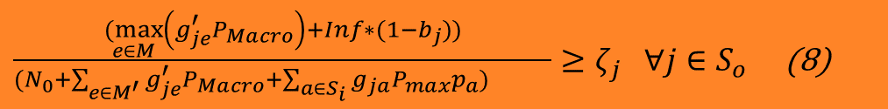
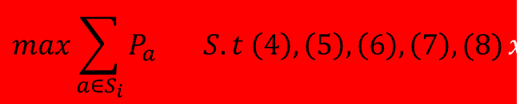
OptFP MIP Formulation
To minimize the impact of interference on the outdoor UEs, we restrict the SINR degradation at each $S_{o}$to be < 2 dB
$\frac{\underset{e∈M}{(max}\left(g_{je}^{′}P_{Macro}\right)+Inf∗(1−b_{j}))}{(N_{0}+\sum_{e∈M^{′}}{g_{je}^{′}P_{Macro}+\sum_{a∈S_{i}}{g_{ja}P_{max}p_{a})} }}≥ζ_{j} ∀j∈S_{o}$ (8)
$$M^{′} ≡M \backslash arg{\max_{e∈M}\left(g_{je}^{′}P_{Macro}\right), ∀j∈S_{o}}$$
Finally the OptFP MIP is formulated as follows,
$$max\sum_{a∈S_{i}}{P_{a} S.t \left(4\right), \left(5\right), \left(6\right), \left(7\right), (8)}x$$
Notes:
Outer sub-region j is assumed to be attached to Macro BS

Slide 19
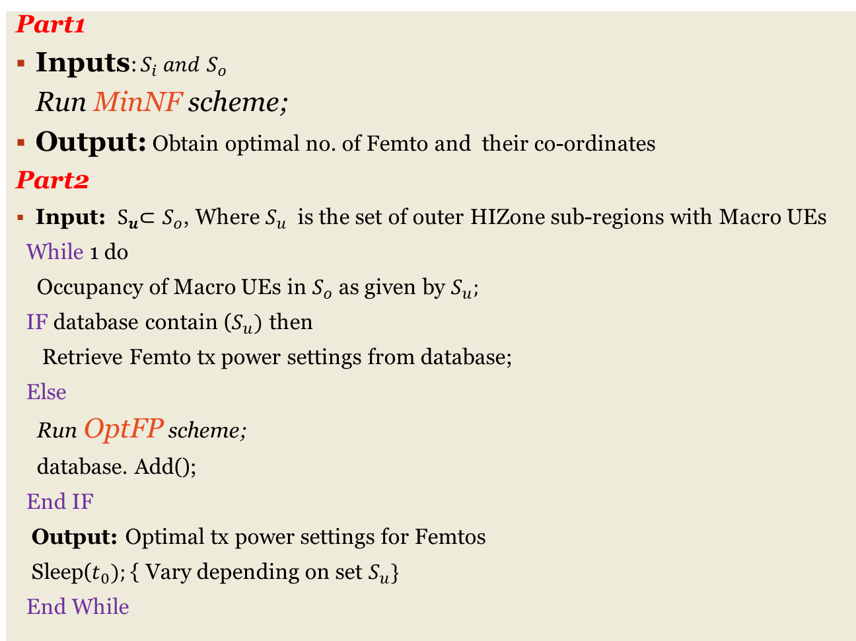
SON based Placement and Power Control Algorithm
Part1
Inputs: $S_{i} and S_{o}$
Run MinNF scheme;
Output: Obtain optimal no. of Femto and their co-ordinates
Part2
Input: ${ S}_{u}⊂S_{o}$, Where $S_{u}$ is the set of outer HIZone sub-regions with Macro UEs
While 1 do
Occupancy of Macro UEs in $S_{o}$ as given by $S_{u};$
IF database contain ($S_{u})$ then
Retrieve Femto tx power settings from database;
Else
Run OptFP scheme;
database. Add();
End IF
Output: Optimal tx power settings for Femtos
Sleep($t_{0});${ Vary depending on set $S_{u}\}$
End While

Slide 20
Simulation Parameters
Parameters | Values
Building Dimensions | 48 m X 48 m X 3m
Number of Rooms | 16
Room Dimensions | 12 m X 12 m X 3 m
Number of inner sub-regions | 144
Number of outer sub-regions | 52
Inner sub-region dimension | 4 m X 4 m X 3 m
Number of Floors | 1
Floor and Wall loss | 10 dB and 8 dB
Femto and Macro Tx Powers | 20 dBm and 46 dBm
Macro BS height | 30 m
Mathematical Solver used | GAMS Cplex (branch-and-bound framework)
LTE System Model | MATLAB based
Notes:
0.1 W & 40 W

Slide 21
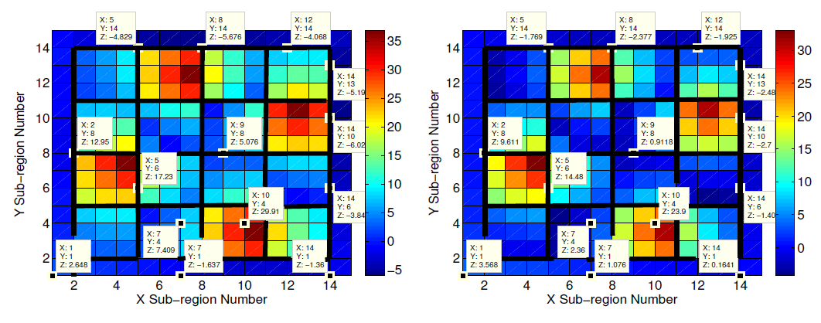
SINR REM plots for MinNF and OptFP
SINR = -5 dB
SINR = -2 dB
HIZone
Full Power Femto (MinNF)
Power Control Femto (OptFP)
eNodeB

Slide 22
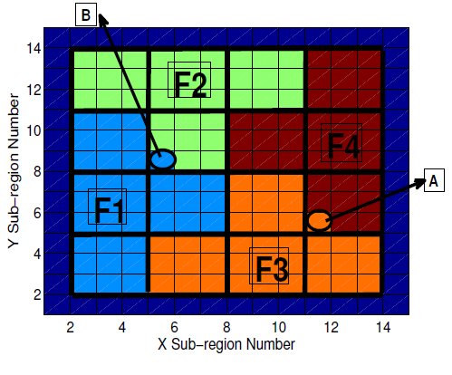
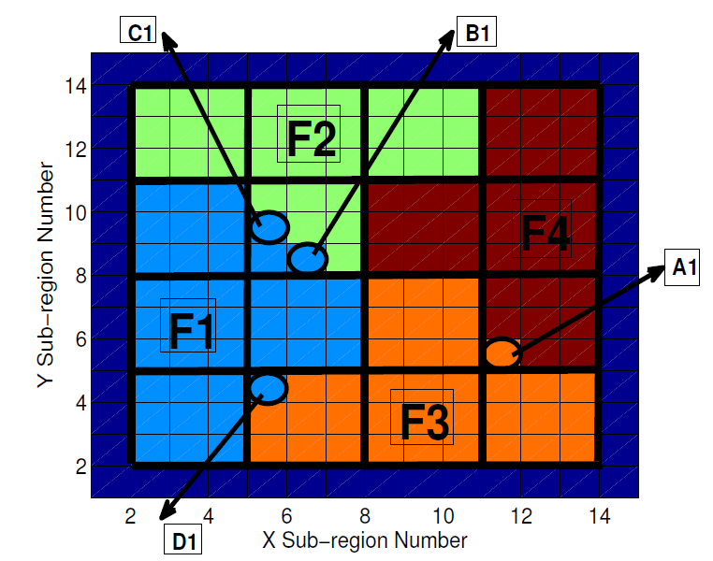
Sub-region association in MinNF and OptFP
Full Power Femto (MinNF)
Power Control Femto (OptFP)
Notes:
IF we observe Fig (a) and Fig (b) there are change in Femto serving region due to dynamic Femto power control
Because some sub-region cant able to maintain the SINR threshold.

Slide 23
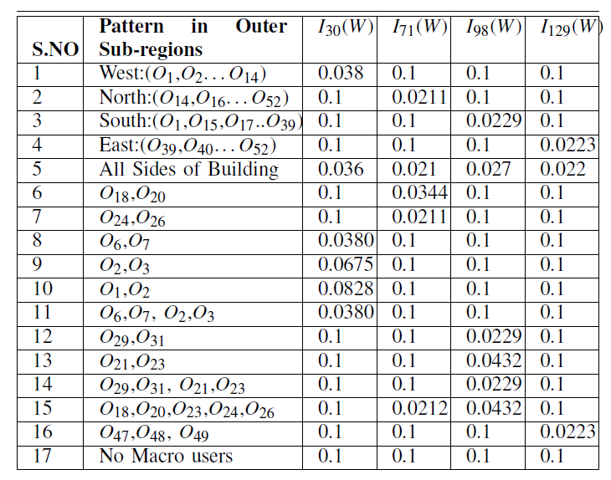
Optimal Femtos Tx Power in Watts
Power Reduced on One Side
Less Power
Power Reduced on One Femto
Max Power

Slide 24
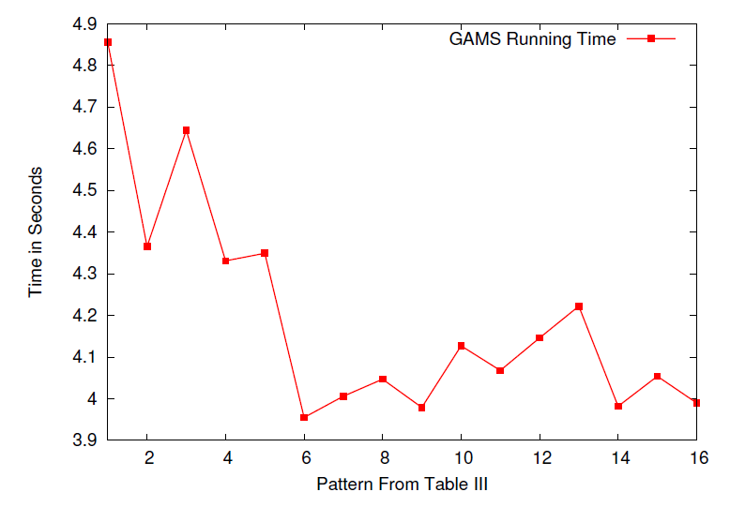
GAMS Running Time

Slide 25
Summary and Future Work
The efficient Femto placement and dynamic power control algorithm dynamically adjusts the transmit power and ensures fair SINR allocation to both indoor and outdoor UEs in LTE HetNets
Current works
  Studying for more complex buildings, with multiple floors
  Consider Open/Hybrid access modes
  D2D to serve HIZone UEs
  Measuring performance using system level simulations in NS-3

Slide 26
Acknowledgments
This work was funded by the Deity, Govt. of India (Grant No. 13(6)/2010CC&BT)
IIT Hyderabad

Slide 27
Thank you!
Feedback ?
tbr@iith.ac.in
Notes:
27

